Slide 1
Temperature Variation in Delhi
Ivy Gu, Eric Lian, Jayden Zhou

Slide 2
Dataset Overview
What is the goal of our project
How our dataset looks like

Slide 3
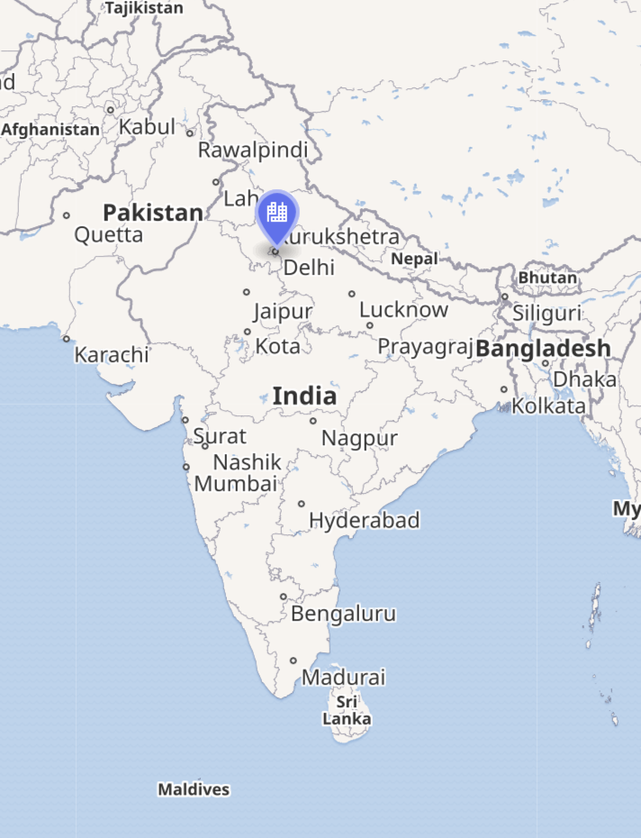
Dataset Overview
Area Delhi, India
Motivation
Monsoon climate
Delhi features a dry winter humid subtropical climate bordering a hot semi-arid climate
Goal
Find best fitted model for the temperature variation in Delhi

Slide 4
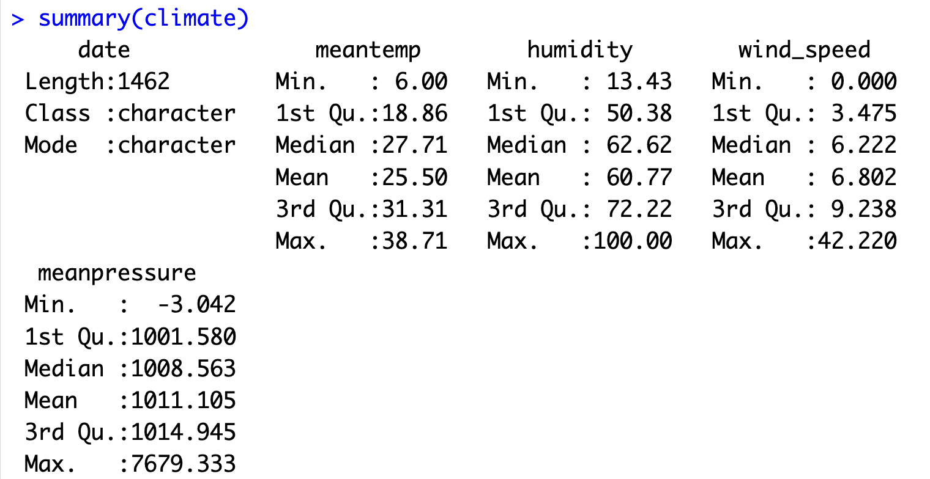
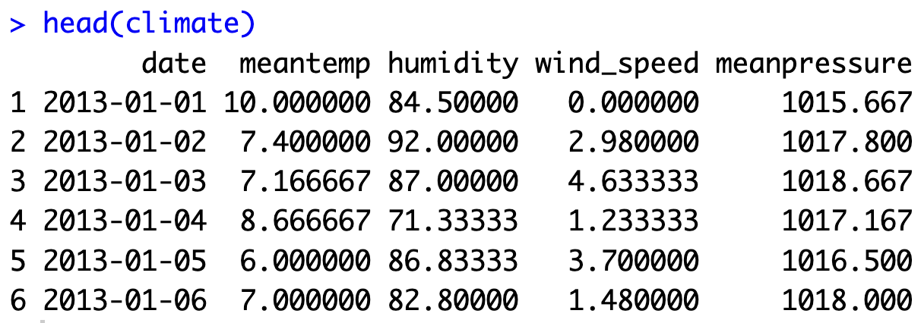
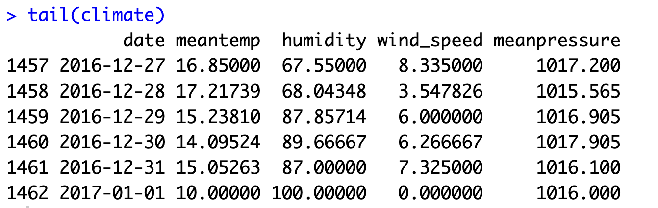
Dataset Overview
Sample size: 1462
Response: Mean temperature
Predictors: Humidity(%), Wind speed(kmph), Mean pressure(hPa)
Date: Year-Month-Day

Slide 5
Data Preprocessing
Data cleaning
Variables selection and checking

Slide 6
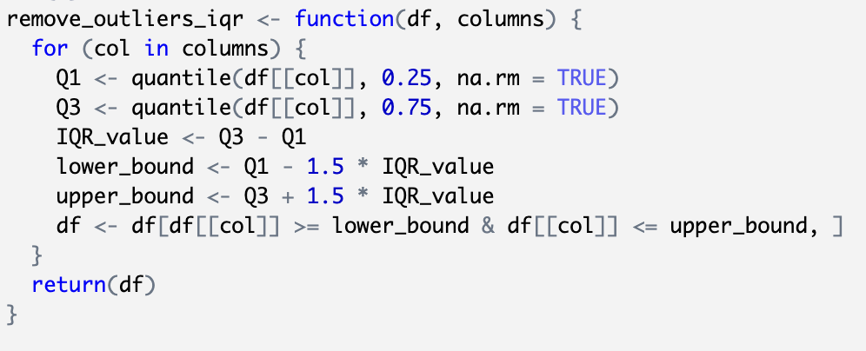
Data Cleaning
IQR → outliers
Remove 43 outliers
Groupby into Months for more clear climate pattern in Delhi

Slide 7
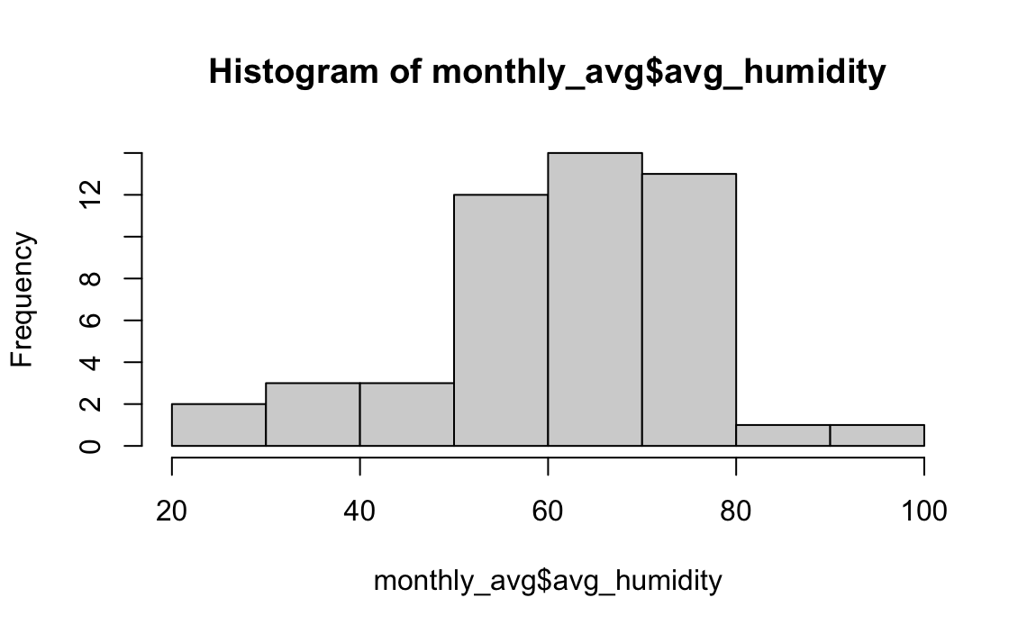
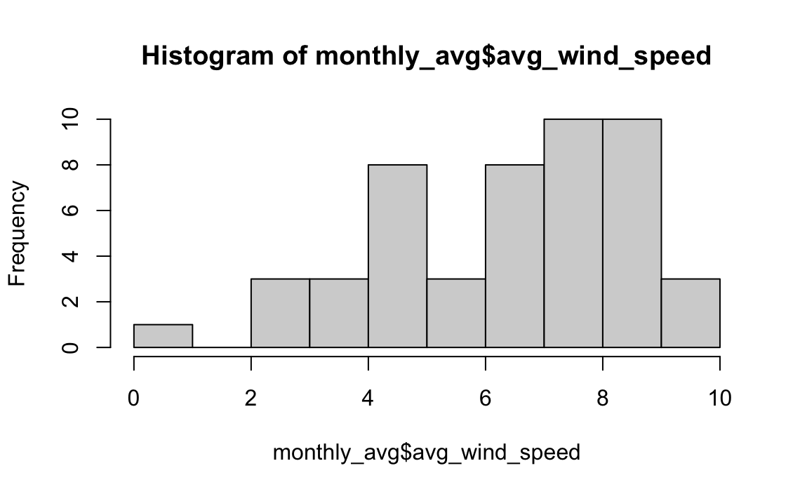
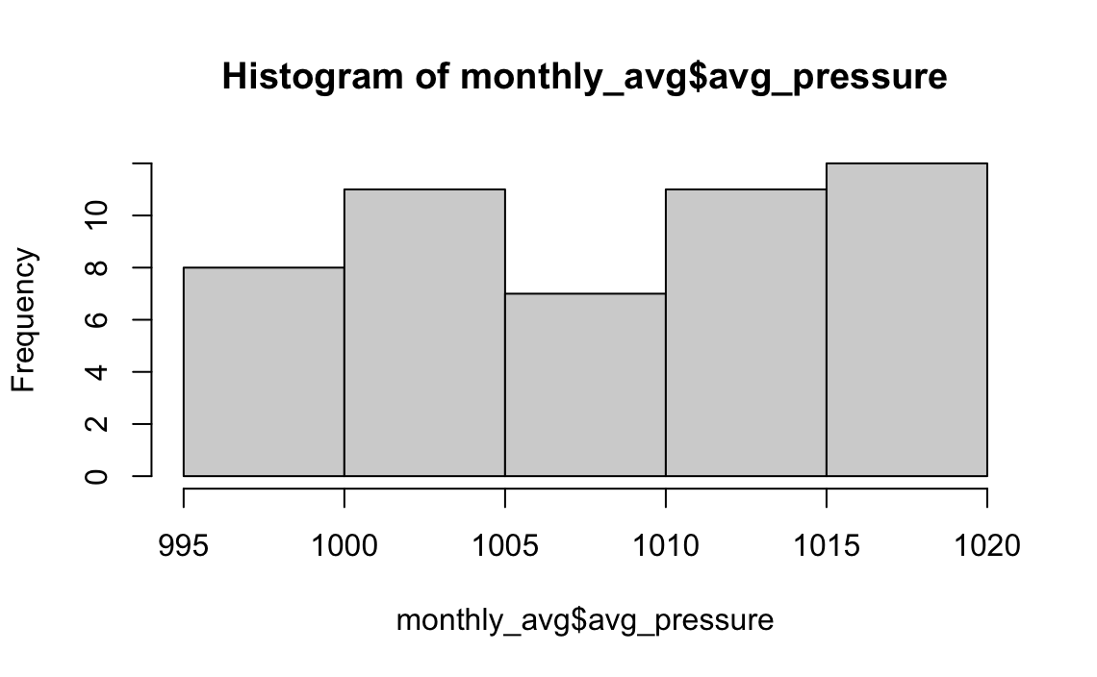
Histogram for Each Predictor
Distribution feature: approximately normal distributed
Conclusion: use original dataset for the regression model fitting

Slide 8
Simple Model Diagnostics
Checking possible issue with the original dataset with regression model

Slide 9
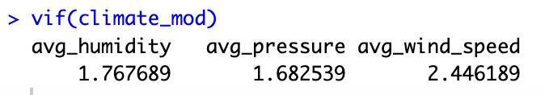

Collinearity Check
VIF check: all smaller than 10 -> no collinearity problem
Condition number check: 2.822880 < 30 -> no collinearity problem

Slide 10
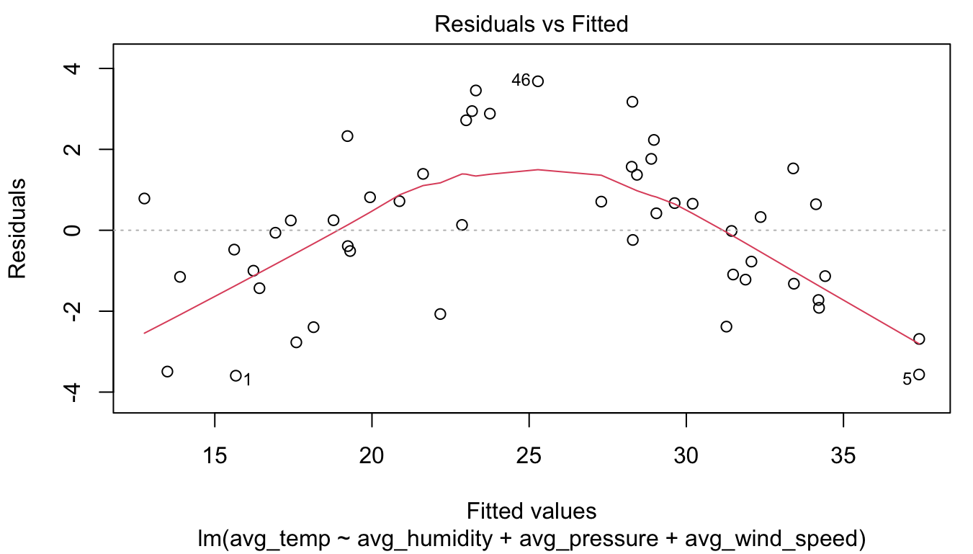
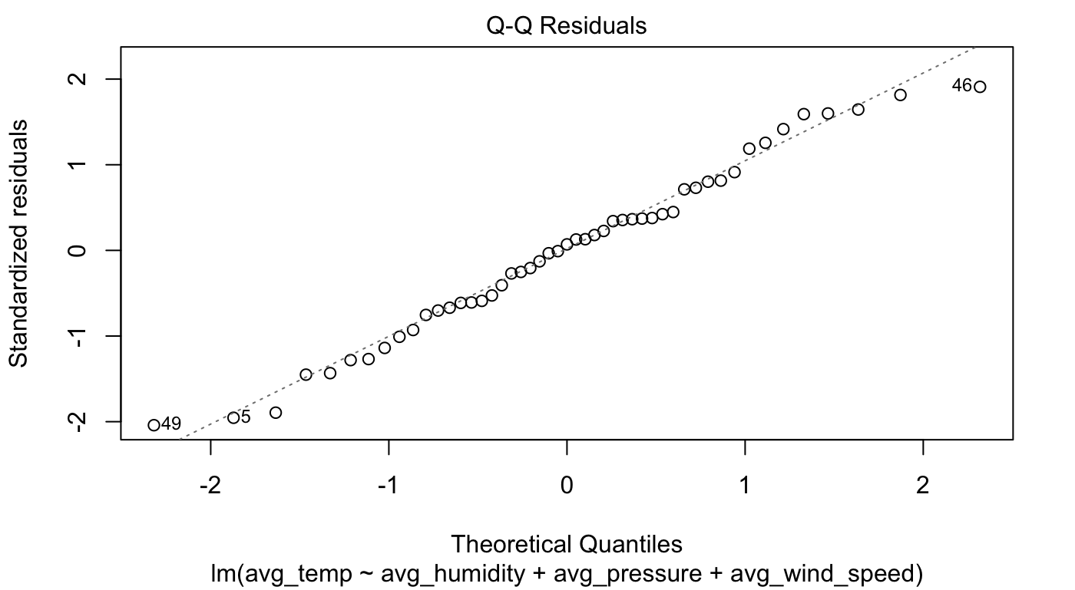
Model Diagnostics lm(avg_temp ~.)
Residual Plot : Convex→ possible nonlinearity
Q-Q Plot : possible normality issue

Slide 11
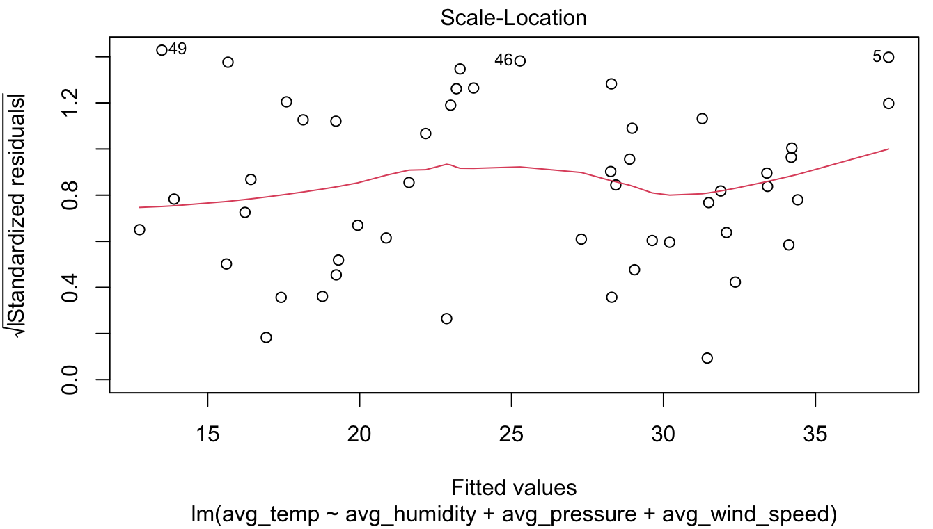
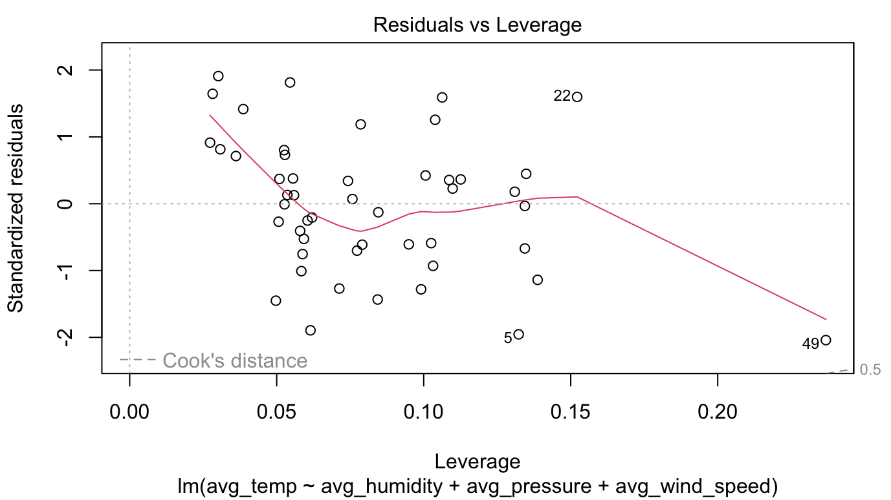
Model Diagnostics lm(avg_temp ~.)
Possibly no non-constant variance issue
No influential point

Slide 12
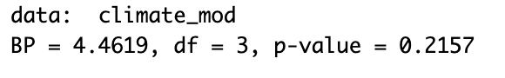
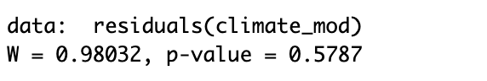
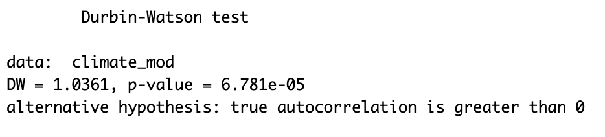
Model Diagnostics lm(avg_temp ~.)
bptest:
No non-constant variance issue
swtest:
No normality issue
dwtest:
Auto-correlation issue

Slide 13
GLS Model
Fitting GLS with AR1 model structure

Slide 14
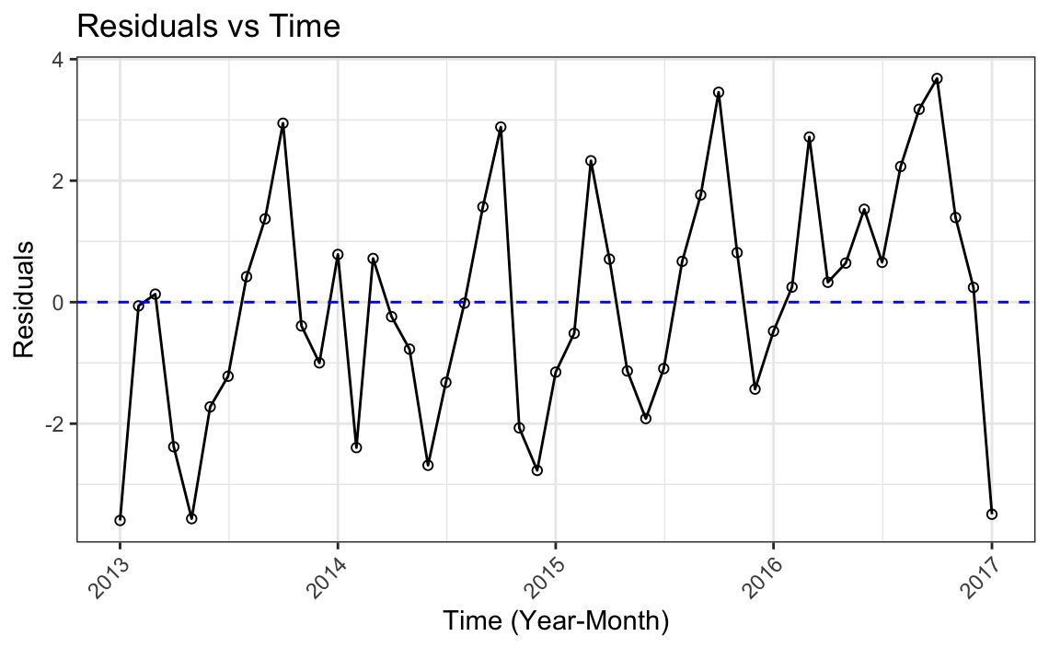
Autocorrelation: Residuals vs. Time
Patterns
Yearly regression pattern

Slide 15
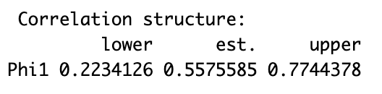
Autocorrelation: AR(1) Structure
The interval does not capture 0 → AR(1)

Slide 16
Model With Dummy Variables
Observing seasonal(monthly) pattern and fitting new model
Season: 4 levels → 3 dummy variables

Slide 17
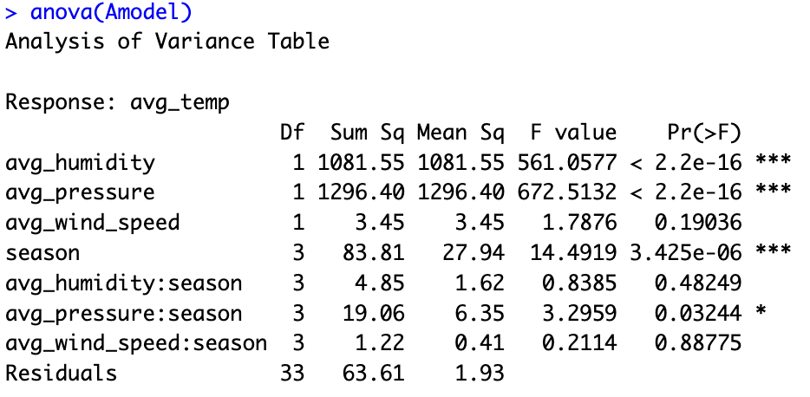
The interaction model → avg_wind_speed:season is not significant

Slide 18
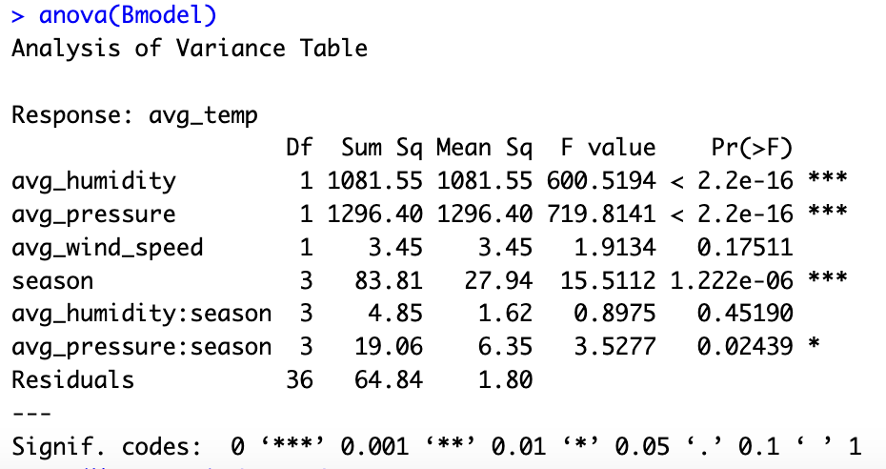
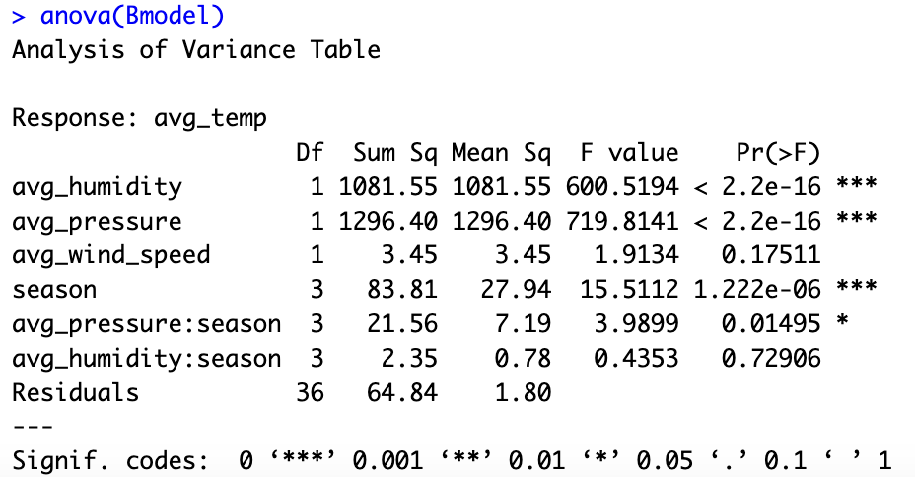
Remove avg_wind_speed:season and refit → avg_humidity:season is not significant

Slide 19
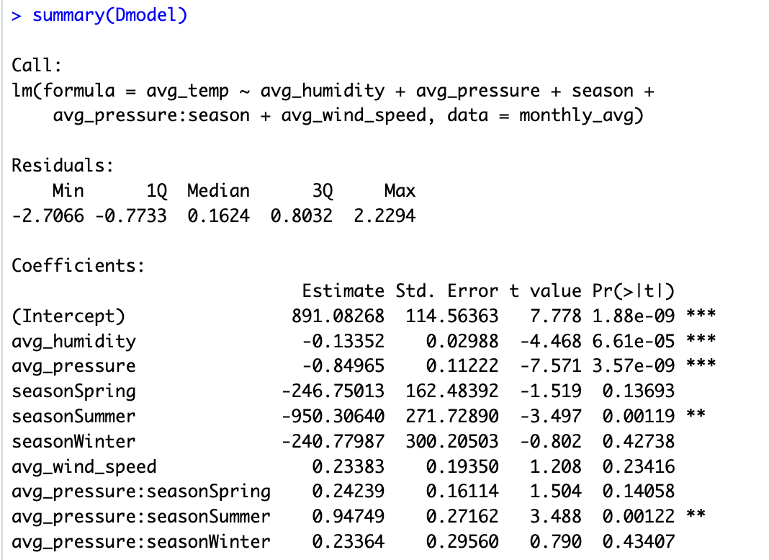
Remove avg_humidity:season and refit → avg_wind_speed is not significant

Slide 20
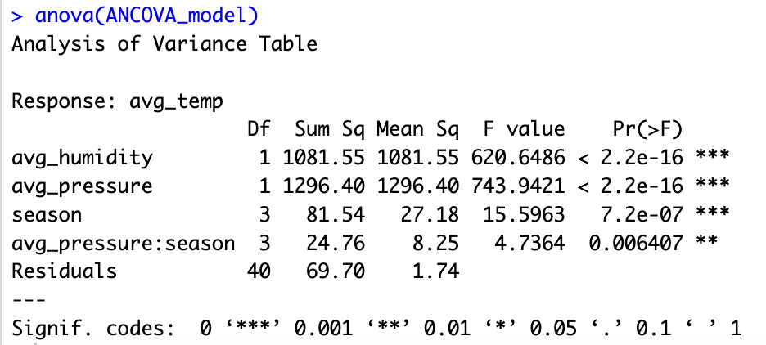
Final Model: lm(avg_temp ~ avg_humidity + avg_pressure + season + avg_pressure:season)

Slide 21
Model Comparison
Which model has better result and main takeaway

Slide 22

Criterion: RMSE of the model
RMSE of GLS model in training dataset:
Selected ANCOVA model: avg_temp ~ avg_humidity + avg_pressure + season + avg_pressure:season

Slide 23
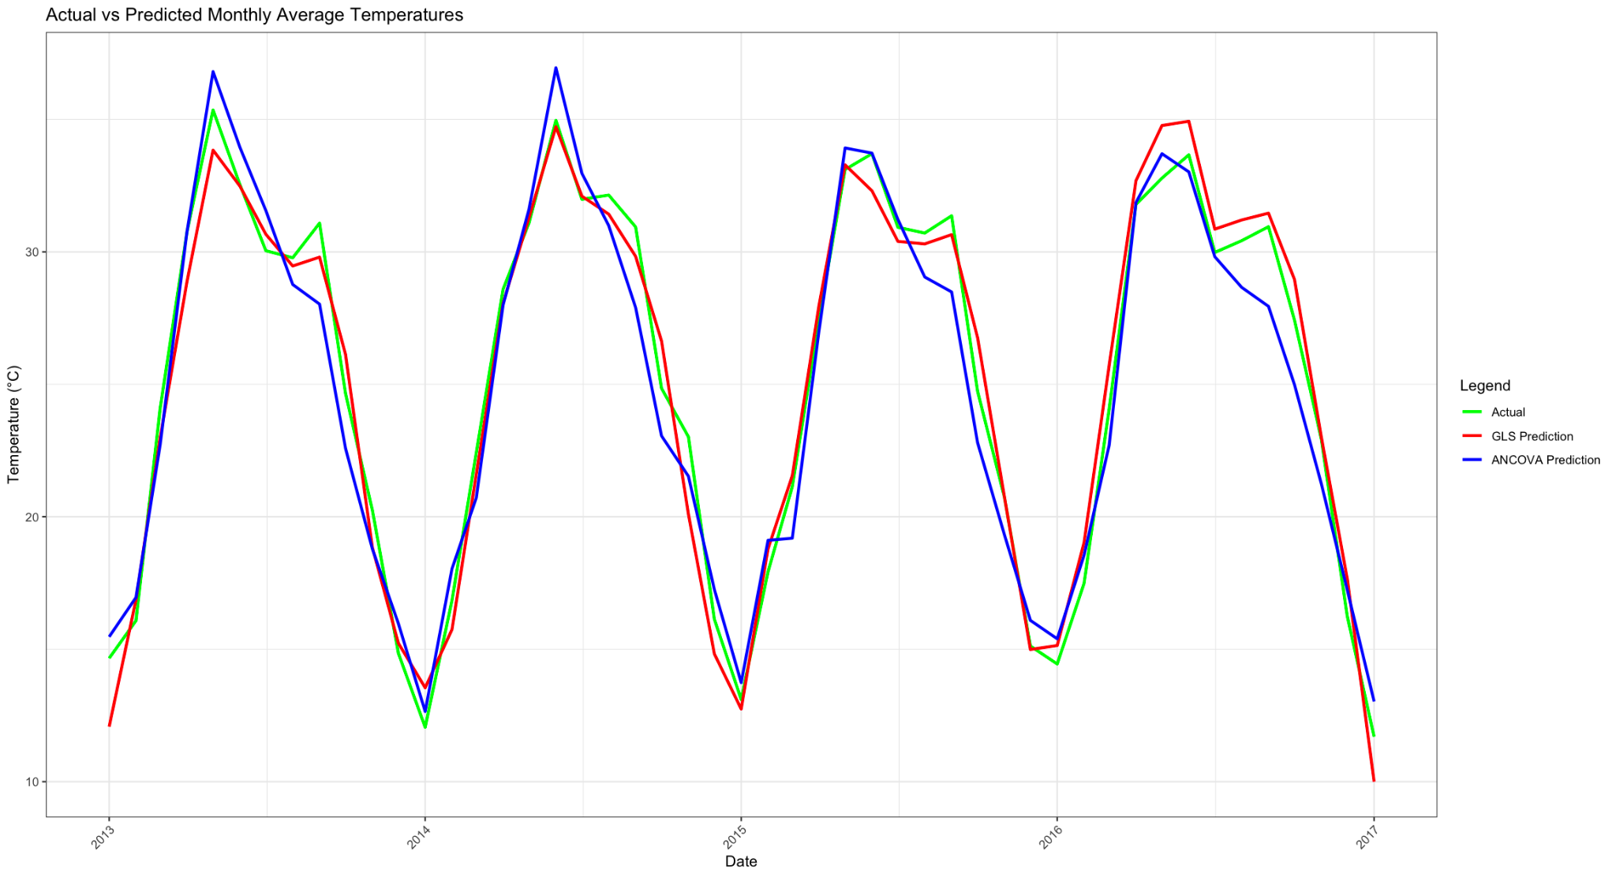
Takeaway
Selected ANCOVA model has a better predict result
Model prediction is relatively bad with the extreme values
Further improvement: consider about time series model or finding other dummy variables

Slide 24
Q & A

